Slide 1
Cardiovascular Disease Prediction Using Machine Learning
Final Year Project · Machine Learning
Comparing seven classification models on 70,000 real patient examination records
Md Abu Said · CS 2203048
Supervisor: Tanvir Ahmed
Department of Computer Science and Engineering (CSE)
National Institute of Textile Engineering and Research (NITER)
Notes:
Introduce yourself and the project. We trained seven different machine learning models to predict whether a patient has cardiovascular disease, using a real 70,000-record dataset, and compared them fairly with the same train, validation and test split. Mention your name, ID, supervisor Tanvir Ahmed, the CSE department and NITER.

Slide 2
Project goal
Predict whether a patient has cardiovascular disease from 11 examination and lifestyle measurements, then find which algorithm does it best.
Predict
Compare
Evaluate
Binary target: cardio is 1 (disease) or 0 (no disease).
Seven algorithms trained on exactly the same data split.
Accuracy, precision, recall, F1 and ROC-AUC on unseen test data.
Cardiovascular Disease Prediction Using Machine Learning · 2 / 12
Notes:
State the goal clearly. The task is binary classification: from a patient's age, body measurements, blood pressure, cholesterol, glucose and lifestyle habits, predict whether they have cardiovascular disease. We compare seven algorithms fairly and judge them on data they never saw during training.

Slide 3
The dataset
70,000
11
50%
1,409
patient records (rows)
features, plus 1 target (cardio)
have the disease (34,979 of 70,000)
rows removed in cleaning (68,591 kept)
Real medical examination data (Kaggle Cardiovascular Disease dataset): age, gender, height, weight, blood pressure, cholesterol, glucose, smoking, alcohol and physical activity.
Cardiovascular Disease Prediction Using Machine Learning · 3 / 12
Notes:
The dataset has 70,000 rows and 11 input features plus the target column cardio. The classes are almost perfectly balanced, so accuracy is a trustworthy metric. The data is real, but it contains data-entry errors, such as blood pressure of 16,020 or minus 150, so cleaning is a necessary step. After cleaning we keep 68,591 rows.

Slide 4
Data preparation
1. Clean the data
2. Features ready
Age from days to years; remove impossible blood pressure, height and weight values and duplicates.
All 11 features are already numeric, so no text encoding is needed.
3. Split 70 / 15 / 15
4. Scale features
Train 48,013 · Validation 10,289 · Test 10,289, stratified so both classes keep the same ratio.
StandardScaler is fitted on the training set only, so no test information leaks in.
Cardiovascular Disease Prediction Using Machine Learning · 4 / 12
Notes:
Walk through the four steps. Cleaning removed 1,409 rows with impossible values: for example systolic pressure below diastolic, or blood pressure over 250. The key point in step 4: the scaler learns its mean and standard deviation from the training data only, then applies them to validation and test data, which prevents data leakage. Scaled data is used by Logistic Regression, Linear Regression, SVM, KNN and the CNN; Decision Tree and XGBoost use unscaled data.

Slide 5
Seven models compared
Model | How it decides
Logistic Regression | Turns a weighted sum of features into a probability
Decision Tree | Follows a chain of yes/no questions
Linear Regression | Fits a line; output of 0.5 or more means disease
SVM (RBF kernel) | Finds the best curved boundary between the classes
XGBoost | Many small trees, each correcting the previous errors
K-Nearest Neighbors | Takes a vote among the K most similar patients
1D CNN (deep learning) | Convolution filters scan the feature sequence for patterns
Cardiovascular Disease Prediction Using Machine Learning · 5 / 12
Notes:
One line per model. Mention that Linear Regression is really a number-predicting method, so we used a 0.5 threshold to turn its output into a class; it is included as a baseline for comparison, and Logistic Regression is the proper choice for classification. The CNN is a 1D convolutional network applied to tabular data.

Slide 6
Using the validation set
The validation set tunes each model, so the test set stays untouched until the final score.
Decision Tree
KNN
max_depth tried from 1 to 20. Best on validation: depth 8.
K tried from 3 to 51. Best on validation: K = 51, the largest value tried.
XGBoost
CNN
Up to 500 rounds; stops early after 20 rounds without validation improvement.
Up to 50 epochs; early stopping with patience 5 on validation loss.
Cardiovascular Disease Prediction Using Machine Learning · 6 / 12
Notes:
Explain the three-way split. Train data is where the model learns. Validation data is used to choose settings such as tree depth or K, and to stop training before overfitting. Test data is used once at the end, so the final numbers are an honest estimate for new patients. For KNN the best K was the largest value we tried, so a larger K might do slightly better.

Slide 7
Test-set results
Model | Accuracy | Recall | ROC-AUC
XGBoost | 73.2% | 67.8% | 0.8033
1D CNN | 73.1% | 68.4% | 0.8006
Logistic Regression | 72.5% | 66.1% | 0.7939
Linear Regression | 72.2% | 64.9% | 0.7934
KNN (K = 51) | 72.3% | 66.7% | 0.7920
SVM | 73.0% | 66.4% | 0.7917
Decision Tree (depth 8) | 73.0% | 67.4% | 0.7896
Evaluated on the 10,289-patient test set, sorted by ROC-AUC.
Cardiovascular Disease Prediction Using Machine Learning · 7 / 12
Notes:
All numbers come from the held-out test set of 10,289 patients. XGBoost and the 1D CNN lead with ROC-AUC of about 0.80 and accuracy of about 73 percent. The other five models are within about one percentage point of them in accuracy. Recall ranges from about 65 to 68 percent across all seven models. The differences between models are small, so do not over-interpret the ranking.

Slide 8
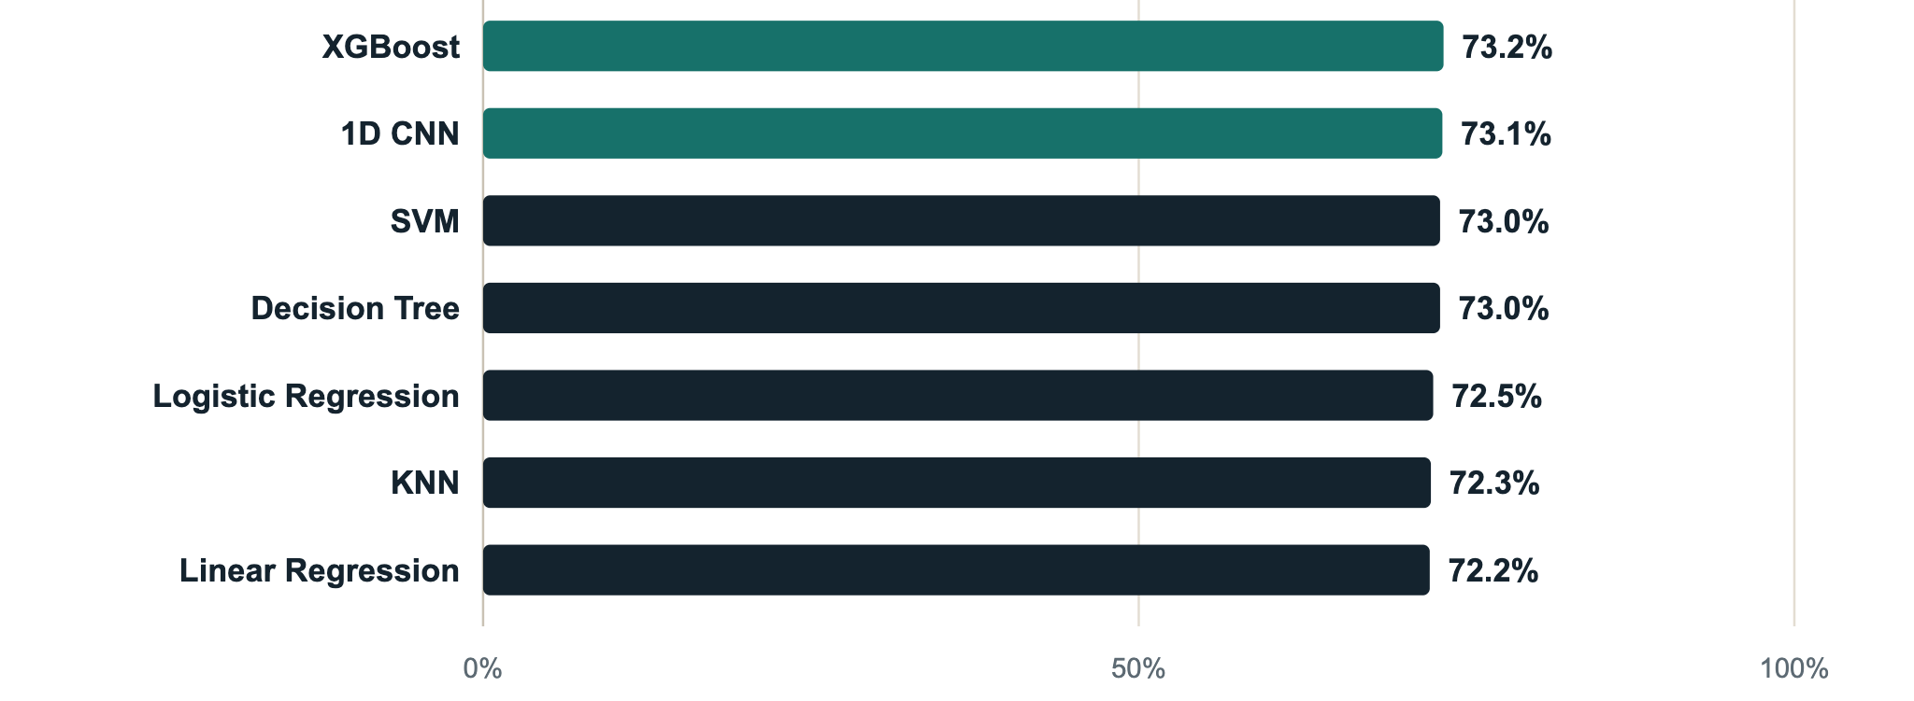
Accuracy by model
Cardiovascular Disease Prediction Using Machine Learning · 8 / 12
Notes:
The same accuracy numbers as a chart, starting from zero so the scale is honest. All seven models land within about one percentage point of each other, between 72 and 73 percent. XGBoost and the CNN (green) are marginally ahead.

Slide 9
Why the models score alike
This is real examination data with only 11 features. The signal in it is limited, so very different algorithms, from Logistic Regression to a CNN, reach nearly the same accuracy of 72 to 73% and ROC-AUC of 0.79 to 0.80.
Strongest correlation with the target
Systolic blood pressure (0.43), diastolic blood pressure (0.34), age (0.24), cholesterol (0.22) and weight (0.18).
Cardiovascular Disease Prediction Using Machine Learning · 9 / 12
Notes:
This is the key interpretation slide. With real data the ceiling is set by what the 11 measurements can tell us, so a simple Logistic Regression is almost as good as the more complex models. Do not read small differences between models as meaningful: they are within normal variation for a test set of this size. Correlations are from the cleaned data. The scaler was fitted on training data only, so there is no data leakage.

Slide 10
Limitations
Limited features
Missed patients
Not for diagnosis
Only 11 measurements, so there is a ceiling on what any model can learn.
Recall is about 65 to 68% across the models, so roughly one in three patients with the disease is missed.
A learning project; input errors were cleaned with simple rules and the results are not clinically validated.
Cardiovascular Disease Prediction Using Machine Learning · 10 / 12
Notes:
Be upfront about the limits. In medicine a false negative, a sick patient the model calls healthy, is the costliest error, which is why recall matters as much as accuracy. Linear Regression is included only as a baseline because it predicts numbers rather than classes. This work is not a diagnostic tool.

Slide 11
Conclusion
Close results
Why
Fair evaluation
All seven models scored 72 to 73% accuracy. XGBoost and the CNN led on ROC-AUC at about 0.80.
Real data with only 11 features limits how much any algorithm can learn.
Validation-based tuning and train-only scaling kept the test scores honest.
Future work
Add features such as BMI, use cross-validation and grid search, and tune the threshold for higher recall.
Cardiovascular Disease Prediction Using Machine Learning · 11 / 12
Notes:
Summarise the takeaways, then mention future work. The main lesson is not only which model won, but that on real data many different algorithms land at nearly the same accuracy, and that a fair evaluation needs a validation set for tuning and an untouched test set for the final score. Next steps: new features such as BMI, cross-validation, hyperparameter search and a recall-focused decision threshold.

Slide 12
Thank you
Cardiovascular Disease Prediction Using Machine Learning
Questions are welcome.
Md Abu Said · CS 2203048 · CSE, NITER
Notes:
Thank the audience and invite questions. Likely questions: why all models score about the same (real data, only 11 features), why scaling was fitted on training data only (no leakage), how the impossible blood pressure values were handled (removed), and why Linear Regression was included (baseline).

